Slide 1


Slide 2



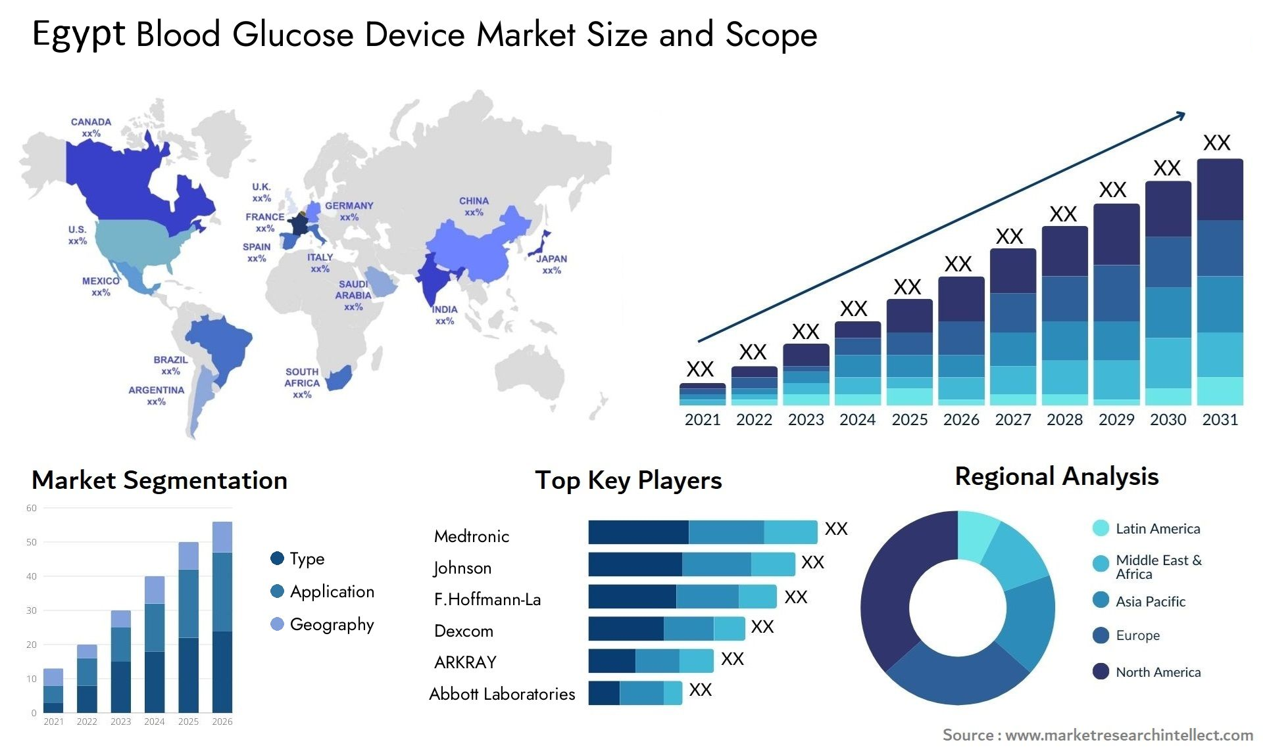

Egypt Diabetes Care Devices Market
Presented by:
  Ahmed Zakaria
  Pharmacist Alex, 2002
  18 Years Experience in Pharma.
  5 Years in Home Care Medical Devices
  Market Access Manager
  Home Care Devices
  Egypt & Saudi Arabia

Slide 3
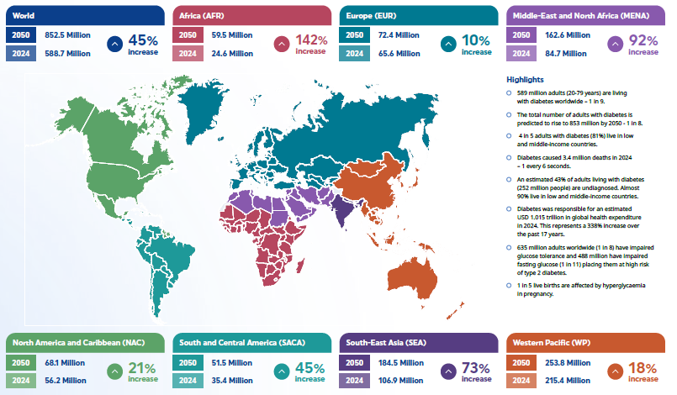

Slide 4
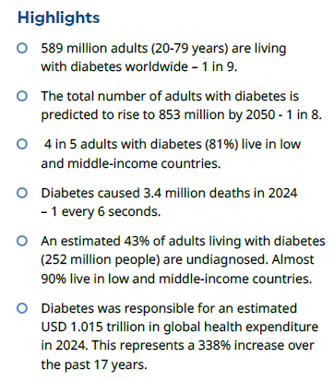
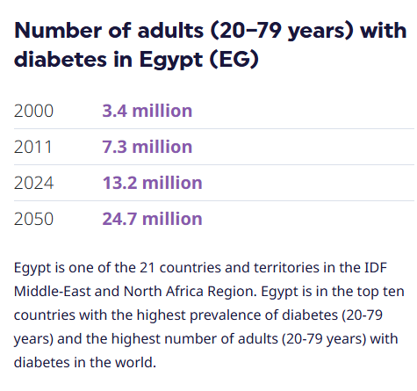
Diabetes in Numbers
In the middle east

Slide 5
Diabetes in Egypt
Prevalence (20y-80y) :
Diabetic patients 13.2 M.
Diagnosed 5.4 M.
Undiagnosed 7.8 M.
People with IGT 11.4 M.
Impaired fasting glucose (IFG) 5.4M.

Slide 6
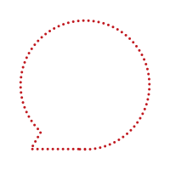








Types of Diabetes
4-10%
90%
2-5%
Type 1
Type 2
Gestational
Type 1 diabetes is caused by an autoimmune reaction in which the body's immune system attacks insulin-producing β cells in the pancreas. As a result, the body produces no or very little insulin.
Type 2 diabetes is the most common form of diabetes. Originally, hyperglycemia (high blood glucose) was caused by the body's cells failing to respond adequately to insulin, a condition defined as ‘insulin resistance’.
Gestational diabetes mellitus (GDM) is characterized by elevated blood glucose levels during pregnancy. GDM can occur at any time during pregnancy (but most likely after 24 weeks) and usually goes away after the end of pregnancy, but there is still a risk of developing type 2 diabetes later in life.
Multiple daily insulin injections
Use insulin when needed
Eat healthily
Use insulin when needed
Eat healthily
Use insulin pump to treat
Exercise
Other medication
Exercise
Other medication

Slide 7
Global Diabetes Economics
In 2024, global diabetes-related health expenditure estimated USD 1 trillion; however,
there is no specific breakdown available for spending solely on medical devices.
These figures include all aspects of diabetes care, including:
  Medical devices
  Medications
  Hospitalizations
  Others
The Medical Devices segment accounts for approximately 8-18% of health expenditures.
Self-Monitoring Blood Glucose (BGM) devices currently hold a significant market share of the diabetes medical device segment due to their affordability and ease of use.
The Continuous Glucose Monitoring (CGM) segment is expected to witness the highest growth rate, this growth is attributed to increasing awareness, technological advancements, and the benefits of real-time glucose monitoring.

Slide 8
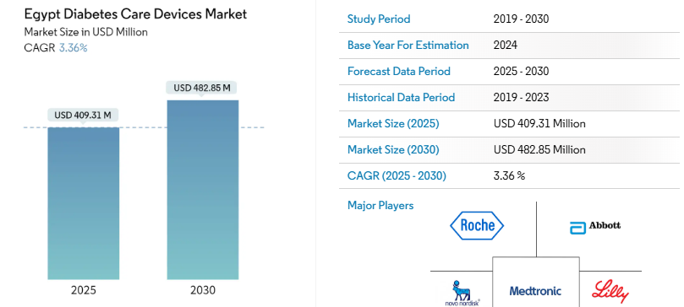
Egypt Diabetes Economics
2024 the total diabetes-related health expenditure in Egypt estimated to be USD 3.1 billion USD.
The Egyptian Diabetes care devices market is a highly growing market estimated to reach USD 410 million in 2025, BGM expected to get 15% market share from this segment.
In CGM market, Egypt is a monopoly market,
FreeStyle Libre introduced by Abbott
on November 2022.
Egyptian Diabetes medical device market
is semi-consolidated, with a mix of
multinational and local players.
Key international players include
Abbott, Roche, Medtronic, Lilly,
and Novo Nordisk.

Slide 9
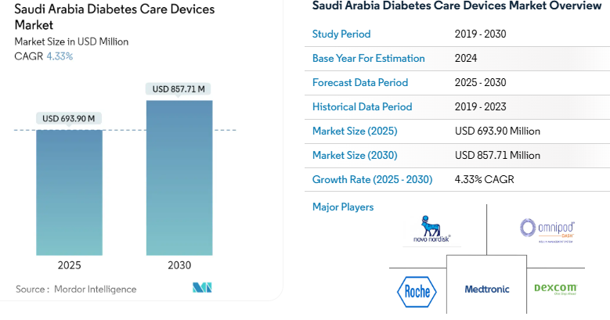
Saudi Arabia Diabetes Economics
2024 the total diabetes-related health expenditure in Saudi estimated to be USD 7.3 billion USD.
The Saudi Diabetes care devices market is a highly growing market estimated to reach USD 700 million in 2025, BGM expected to reach USD 124 million in 2025 from this segment.
In CGM market, Saudi became a highly competitive market:
  FreeStyle Libre by Abbott,
  G6 & G7 by Dexcom,
  iCan by Sinocare,
  GS1 by Sibionics,
  Syai by ottai etc.
  iFree by Bionime,
  CareSens Air by iSens,
  TouchCare by Medtrum.
Key international players include
Abbott, Medtronic, Roche, Dexcom.

Slide 10
Egypt Diabetes Care Devices Market
The Egypt Diabetes Care Devices Market size is estimated at USD 410 million in 2025, and is expected to reach USD 482.85 million by 2030, at a CAGR of 3.36%.
This Value distributed on the following Segments:
Self-Monitoring Blood Glucose Devices:
  BGM: Glucometer Devices, Blood Glucose Test Strips, and Lancets.
CGM: Continuous Glucose Monitoring Devices (Sensors, receivers and Transmitters).
Management Devices:
  (Insulin Pump Devices, Insulin Pump Reservoir, and Infusion Sets).
  Disposables:
    Insulin Syringes
    Cartridges in Reusable Pens
    Disposable Pens
    Jet Injectors

Slide 11
Egypt Diabetes Care Devices Market
BGM Devices currently hold a significant market share, while CGM, expected to
witness the highest growth rate.
The market driven by a mix of multinational and local players.
Key International Players:
  Roche Diabetes Care: Germany, (major player in BGM, ACCU-Check)
  Lifescan: USA, (formerly a J&J company, now owned by Platinum Equity, OneTouch)
  Ascensia: Switzerland, (formed by acquisition of Bayer DC, by Panasonic Healthcare, Contour)
  Abbott Diabetes Care: USA, (significant presence in both SMBG and CGM, FreeStyle)
  Dexcom: USA, (focuses on CGM technology, Dexcom G6, Dexcom G7)
  Medtronic PLC: Ireland, (CGM and insulin pumps, Guardian Sensors, MiniMed insulin pumps)
  Insulet: USA, (innovator in tubeless insulin pump technology - Omnipod)
  Novo Nordisk A/S: Denmark, (insulin and insulin delivery devices, FlexPen, NovoPen)
  Eli Lilly: USA, (insulin and insulin delivery devices, KwikPen)
  Sanofi: France, (key player in insulin and diabetes management, Solostar pen)

Slide 12
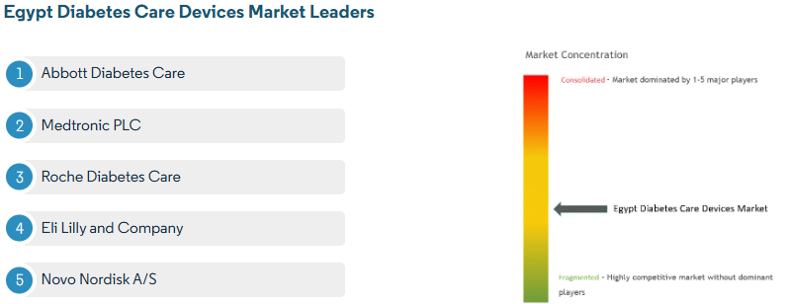
Egypt Diabetes Care Devices Market
Insulin Disposable pens and Cartridges hold the highest share of about 37% in the management devices segment.
Some pens are smart insulin pens that easily connect to an app on the phone to monitor blood sugar levels and remind when to take the next insulin dose.

Slide 13
Egypt Diabetes Care Devices Market
Market Drivers
Rising Prevalence of Diabetes:
  The increasing number of people with both type 1 and type 2 diabetes in Egypt.
  Factors include, sedentary lifestyles, unhealthy dietary habits, and a family history.
Increased Governmental awareness and Healthcare Expenditure:
  Growing awareness about the importance of diabetes management.
  Rising healthcare expenditures and Government initiatives aimed at improving healthcare infrastructure, increasing access to diabetes management tools.
Technological Advancements:
  Innovations in glucose monitoring technology, particularly the development of more accurate, user-friendly, and compact devices like CGMs, are driving market growth.
  Integration of diabetes devices with mobile apps and telehealth services enhances
  patient engagement and disease management.

Slide 14
Egypt Diabetes Care Devices Market
Market Restrictions
High Cost of Advanced Devices:
  The high cost of advanced devices like CGMs and insulin pumps can limit their accessibility for a significant portion of the population, especially in lower-income segments.
Preference for Traditional Therapies:
  Some patients may prefer traditional or complementary therapies over advanced medical devices, potentially limiting market growth.
Lack of Public Awareness:
  Low medical education and awareness impact on increased undiagnosed patients.
  Limited awareness about the benefits of advanced diabetes devices.
lack of access to information:
  Lack of accurate data of market insights and patient segments particularly
  in rural areas.

Slide 15
Egypt Diabetes Care Devices Market
Porter's Five Forces Analysis
Bargaining Power of Suppliers (Low to Moderate):
  Presence of international players who have strong brand recognition and technological expertise.
  However, the presence of generic and local manufacturers can provide some counter-balance.
Bargaining Power of Buyers (High) :
  A large and growing patient base increases their overall importance.
  Price sensitivity, and free replacement offers is a significant factor, especially for BGM.
  The availability of many different brands and product options provides some choice (50 brands).
  Limited by low ratio of boxes of strips per patient per year due to poor insurance systems.
Threat of New Entrants (Low to Moderate):
  Recent high regulatory requirements and long duration for medical device approval in Egypt with EDA, and new ISO regulations (MDR) can affect new players.
  Established players have strong distribution networks and brand recognition.

Slide 16
Egypt Diabetes Care Devices Market
Porter's Five Forces Analysis
Intensity of Competition (High):
  The market includes both multinational corporations and local manufacturers.
  Multinational companies dominates the new innovations, CGM.
  Intensity of competition is very high especially in the BGM market, (50 brands).
  In CGM market, until now it is a monopoly market only freestyle Lybre-2 model.
  Competition exists in terms of product features, accuracy, ease of use, price, and brand reputation.
  Companies engage in marketing and promotional activities to gain market share.
  Mergers, acquisitions, and partnerships among key players are also observed.

Slide 17
Egypt Diabetes Care Devices Market Segmentation
Management Devices
Insulin Pump:
  Insulin Pump Devices: Less common in Egypt compared to other devices due to cost and accessibility, Medtronic dominates this market in Egypt.
  Insulin Pump Reservoirs: Holds the insulin for delivery.
  Infusion Sets: Delivers insulin from the pump to the body.
  Patch pump: tube-free patch pump attached to skin to give an injection.
Insulin Syringes: A traditional and cost-effective method for insulin delivery, still widely used.
Insulin Disposable Pens: Growing in popularity due to their ease of use and portability.
Cartridges and Reusable Pens: Offer convenience and accuracy in insulin dosing.
Smart insulin pens: or connected insulin pens (CIPs), can connect to a smartphone app through Bluetooth and share data with other apps to help make dosage recommendations.
Jet Injectors: A needle-free insulin delivery method, with limited market penetration.

Slide 18
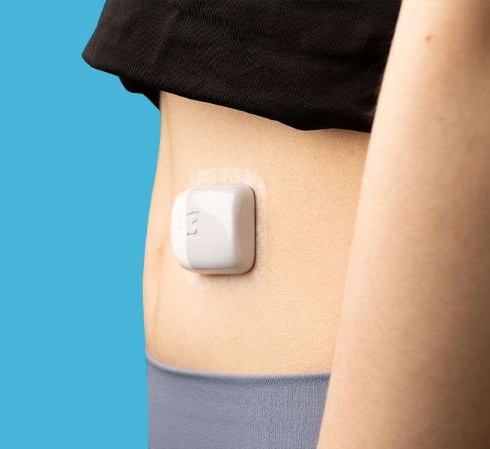
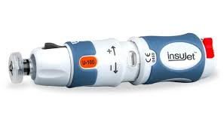
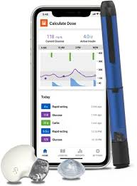
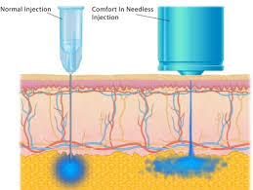
New innovations:
Patch pump
Jet Injectors
Smart insulin pens

Slide 19
Egypt Diabetes Care Devices Market Segmentation
Monitoring Devices
Self-monitoring Blood Glucose Devices (SMBG)
  Glucometer Devices: Widely used due to affordability and ease of use. Market includes various brands with different features.
  Blood Glucose Test Strips: Recurring revenue stream, with demand directly linked to the number of glucometers in use and testing frequency. Cost is a significant factor for patients.
  Lancets: Essential consumables for blood glucose testing.
Continuous Glucose Monitoring Devices (CGM)
  Sensors: Require frequent replacement (typically every 7-15 days). This segment is expected to see high growth.
  Durables (Receivers and Transmitters): The electronic components of CGM systems, new models depend on the mobile Applications.

Slide 20
Self-monitoring Blood Glucose Devices (SMBG)
History of Glucometers
Urine glucose testing came in 1908 when Benedict developed a copper reagent for urine glucose, which was used for over 50 years.
Glucose was the target of the first enzymatic biosensor, developed by Clark and Lyons in 1962. And in 1965, Ames developed the Dextrostix, the first blood glucose test strip, using glucose oxidase.
By the mid-1970s, patients started using BGM at home, the first commercial blood glucose analyzer was released by Yellow Springs Instruments (YSI) in 1975, and the first glucose meter by Medisense years later, in 1987.
In 1999, the U.S. FDA approved the first “professional” CGM, with which the patient was blinded to glucose data collected for 3 days.
In 2004, Medtronic introduced the Guardian REAL-Time CGM system, by 2006, Dexcom introduced its first real-time CGM. In 2008, the FreeStyle Navigator
by Abbott was released in the United States.
Notes:
Let’s delay/prevent diabetes shall we….

Slide 21
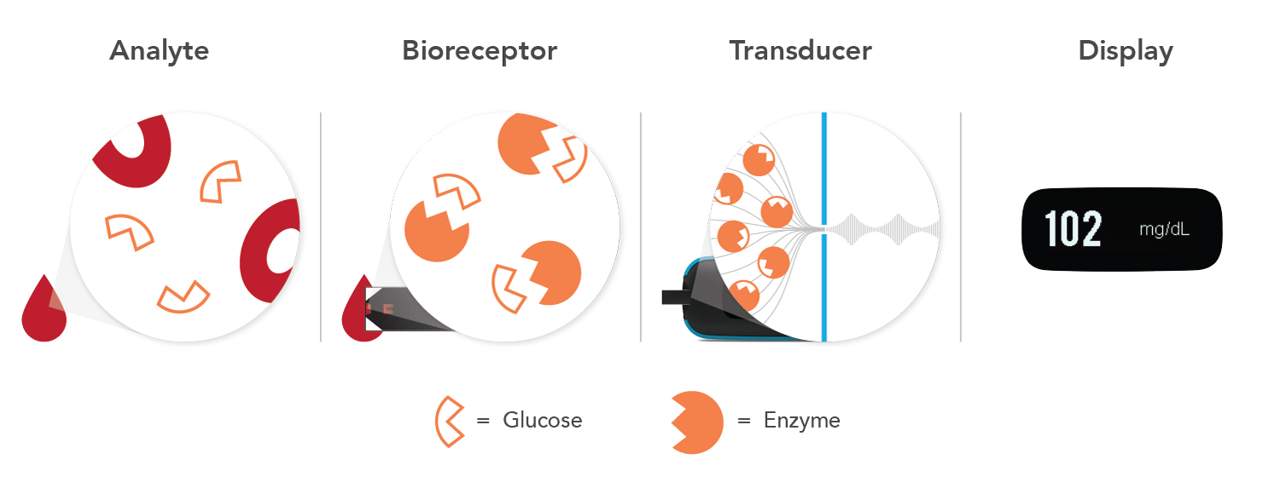
Self-monitoring Blood Glucose Devices (SMBG)
How glucose biosensors Work?
Analyte: A substance that is identified and measured. Here, glucose is the analyte.
Bioreceptor: The test strip contains a specific enzyme that interacts with glucose in blood.
Transducer: This part of the biosensor converts the chemical reaction into electrical current at the bioreceptor (measurable signal).
Electronics and display: The processed signals are then quantified and shown on either the glucose meter’s display or the receiver for a continuous glucose monitor (or app).
Notes:
Let’s delay/prevent diabetes shall we….

Slide 22
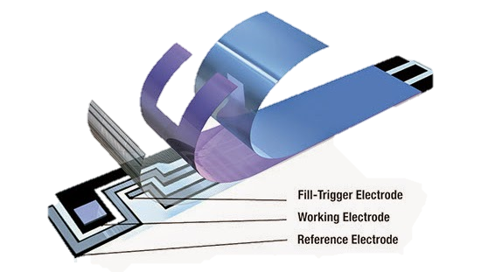
Self-monitoring Blood Glucose Devices (SMBG)
How Glucometers Work?
The glucometer works on the principle of amperometry, where an electric current is obtained during an enzymatic electrochemical reaction.
In each test strip, there is an enzyme. That reacts with the glucose, in the blood sample and creates an acid called gluconic acid.
Electrons are produced during the chemical reaction. These electrons are measured and this is proportional to the concentration of glucose in the solution.
Glucometer test strips, consist of three main electrodes:
  Working (WE),
  Reference (RE), and
  Counter electrodes (CE).
Notes:
Let’s delay/prevent diabetes shall we….

Slide 23
Self-monitoring Blood Glucose Devices (SMBG)
Types of enzymes react with Glucose
Glucose oxidase (GOD): is a typical flavin enzyme, its biological function is to catalyze glucose to form gluconolactone (gluconic acid), and the electrode will detect the mediator.
Glucose + (GOD-FAD) → Gluconolactone + (GOD−FADH2)
(GOD−FADH2) + O2 → (GOD−FAD) + H2O2
Glucose oxidase biosensor strips are often sensitive to oxygen concentration. The mediator and oxygen can both compete to take electrons from the reduced form of the glucose oxidase enzyme (GOD−FADH2).
GOD requires oxygen for its activity, but its concentration changes over time.
Glucose Dehydrogenase (GDH): is an oxidoreductase enzyme that also oxidizes glucose into gluconic acid, but it is unable to use oxygen as an electron acceptor; therefore, it requires the cofactors (e.g., flavin adenine dinucleotide (FAD), nicotine adenine dinucleotide (NAD), or pyrroloquinoline quinone (PQQ)).
Notes:
Let’s delay/prevent diabetes shall we….

Slide 24
Self-monitoring Blood Glucose Devices (SMBG)
Types of enzymes react with Glucose
The GDH technique using pyrroloquinoline quinone (GDH-PQQ): has limitations.
This coenzyme is nonspecific and reacts with other sugars (e.g., maltose, galactose, mannose, xylose, and ribose) and detects them as glucose; alternate techniques should be used when these other sugars are present.
The Food and Drug Administration (FDA) issued a public health notification in 2009, secondary to several deaths, for the use of the GDH-PQQ glucose monitor because of the potentially fatal error related to the interference of other sugars with this methodology.
For example, icodextrin (a substance commonly used in peritoneal dialysis fluid) is broken down to maltose, which is reported as glucose with the (GDH-PQQ).
Notes:
Let’s delay/prevent diabetes shall we….

Slide 25
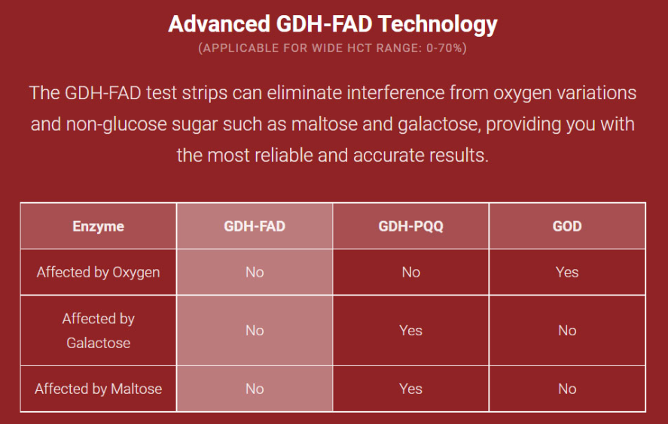
Self-monitoring Blood Glucose Devices (SMBG)
Types of enzymes react with Glucose
Flavin adenine dinucleotide-glucose Dehydrogenase (GDH-FAD): oxygen-independent enzyme that doesn’t interfere with non-glucose sugar.
GDH technique using nicotine adenine dinucleotide (GDH-NAD):
Like (GDH-FAD) enzyme that doesn’t interfere with non-glucose sugar
(NAD) non-covalently attached to carbon electrodes to form a composite that acts as an electronic biosensor, which complicates device fabrication.
Notes:
Let’s delay/prevent diabetes shall we….

Slide 26
Self-monitoring Blood Glucose Devices (SMBG)
Types of enzymes react with Glucose
Glucose Monitor Brand | (Glucose-specific) | Enzyme Type | Manufacturer
OneTouch Ultra | Yes | GOD | Lifescan, Inc.
OneTouch Select | Yes | GOD | Lifescan, Inc.
OnCall | Yes | GOD | ACON LABS INC.
Accu-Chek Go | No | GDH-PQQ | Roche Diagnostics
Accu-Chek Performa | No | GDH-PQQ | Roche Diagnostics
Accu-Chek Aviva 4 | No | GDH-PQQ | Roche Diagnostics
FreeStyle Lite | Yes | GDH-NAD | Abbott
FreeStyle Optium | Yes | GDH-NAD | Abbott
Contour | Yes | GDH-FAD | Bayer
Notes:
Let’s delay/prevent diabetes shall we….

Slide 27
BGM Market Situation Analysis
Private Market: 30% of total market units.
Private Market: 8M units
Private Market: 30M USD

Slide 28
4.0 Competitor analysis
BGM Market Competition Analysis
Product | Manuf. | Origin | Importer | Features | Wholesale Price | Promotion
Caresense | iSense | Korea | Al-Hoda | Affordable prices | 180 LE/50 strip | sales offers
On call Plus | Acon | China | Bioegypt | Affordable prices | 225 LE/50 strip | Replacement / sales offers
Gluco-Dr | allmedicus | Korea | Med Care | Av. Results 7/14/30/90 | 235 LE/50 strip | 10% bonus / lot of agents
Perfecta | Andon | China | Medica tech | Italian-technology | 280 LE/50 strip | Hospital – Clinic promotion
Adura Sanda-Care | Yuwell | China | NasCare | Swiss-made | 210 LE/50 strip | Replacement / E-commerce
Safe AQ series Safe Max series | Sinocare | China | Pharomed SafeHearts | Multi features | 300 LE/50 strip | Clinic promotion / E-commerce

Slide 29
BGM Market Competition Analysis
Brand | Quality | Brand equity | Availability | After sales services | Coverage | Social media activity | Relation with market | Total | AVG %
Accu check | 10 | 10 | 10 | 8 | 10 | 9 | 7 | 64 | 9.1
On-Call | 7 | 7 | 8 | 7 | 8 | 5 | 6 | 48 | 6.9
Gluco-Dr | 7 | 6 | 7 | 7 | 7 | 5 | 6 | 45 | 6.4
Sinocare | 8 | 6 | 6 | 7 | 6 | 4 | 5 | 43 | 6.1
Yuwell | 7 | 6 | 5 | 6 | 6 | 3 | 4 | 37 | 5.3
Perfecta | 6 | 7 | 5 | 6 | 6 | 2 | 3 | 35 | 5

Slide 30
Vendor (Agent)
Distribution channels
Distributer
Wholesaler
Online
Medical Shops
Pharmacies
End users (patients)

Slide 31
Market Segments
patient
Pharmacies
Hospitals
Customer analysis
Medical Shop
Online
pharmaceutical companies

Slide 32
Market Segments
patients
Quality
Affordable prices
(Offer)
After sales services

Slide 33
Market Segments
Pharmacies
individual
Chains
Class A
Class B
Class C
Small
Big
- Accepted Discount
- Medium Collection period
Big Discount
- Long Collection period
Brand then price
Price then Brand
Not interested

Slide 34
Market Segments
Medical Shops
Big medical shop
Distributers
Small Medical shop
80 % of the market ( potential )
Need Big Discounts
Need promotional materials
Very seneitive to stable prices
20 % of the market ( potential )
Accept offers
Need promotional materials
Ask about offers to end users

Slide 35
Brand and Relations
pharmaceutical companies
Social Media Marketing
Health care bloggers
Online marketing
Device Evaluation and competitive prices
Hospitals

Slide 36
Continuous Glucose Monitoring Systems (CGM)
What is Continuous Glucose Monitoring?
A device that automatically measures blood glucose level, throughout the day and night every 1-5 minutes.
Review blood glucose level changes over (10-15) days and give measuring trends.
Monitoring glucose levels in real-time can provide a clear vision of the impact of different types of food and beverages consumed, physical activity importance, and medicine’s role.
How does a CGM work?
A CGM has three parts:
  Sensor: measures the glucose level in the interstitial fluid (in the spaces around cells).
  Transmitter: sends the information wirelessly, to the third part of CGM.
  Receiver: a data analysis software program that is stored on a
  smartphone or reader device.
Notes:
Let’s delay/prevent diabetes shall we….

Slide 37
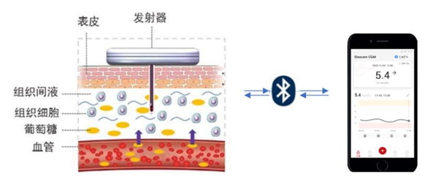
Continuous Glucose Monitoring Systems (CGM)
How does a CGM work?
The sensor probe:
Three-layers structure (semipermeable membrane, glucose enzyme electrode, and substrate).
algorithm
Interstitial fluid glucose concentration
Electrical signal
Blood glucose concentration
Interstitial fluid
Transmitter
Sensor
Notes:
Let’s delay/prevent diabetes shall we….

Slide 38
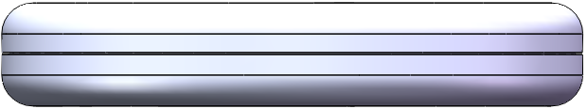

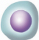
Continuous Glucose Monitoring Systems (CGM)
CGM detects glucose levels in interstitial fluid (the fluid between somatic cells).
Interstitial fluid glucose levels are a reliable indicator of blood glucose because glucose diffuses freely from capillaries into interstitial fluid.
It has been demonstrated that there is a time delay of approximately 10-15 minutes in the diffusion of glucose from capillaries to interstitial fluid
Skin
Transmitter
Interstitial fluid
Sensor
Cell
Glucose
Blood Vessel

Slide 39
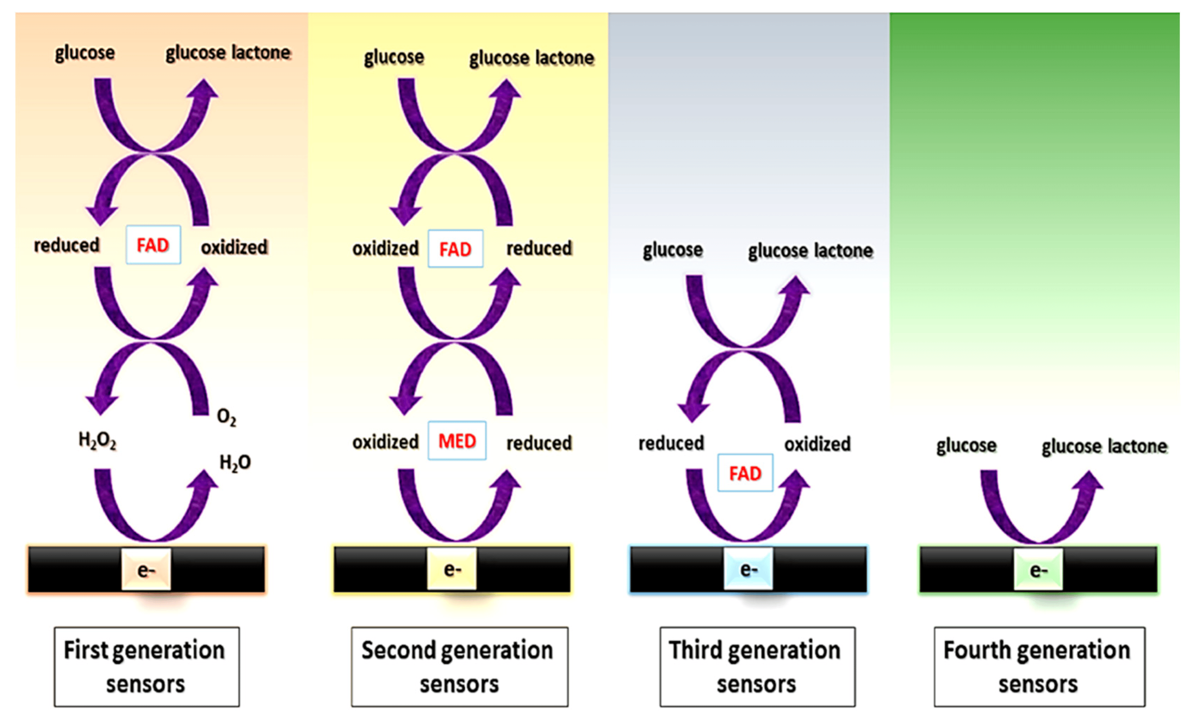
Continuous Glucose Monitoring Systems (CGM)
How does a CGM work?
BGM uses enzyme-coated test strips that are manufactured with a precise amount of specific enzymes that can only react to one blood sample.
Like BGM, CGM uses a filament coated in glucose-sensing enzymes to detect glucose in the interstitial fluid.
Enzymatic Sensors:
Three different “generations” of enzymatic sensors have been described, depending on how enzymes are used.
Notes:
Let’s delay/prevent diabetes shall we….

Slide 40
Continuous Glucose Monitoring Systems (CGM)
How does a CGM work?
First generation: their principle is based on the use of oxygen as a co-substrate, producing H2O2 as the enzymatic reaction product, which is measured.
Second generation: they overcome the limitation coming from H2O2 by using redox mediators as co-substrates, which ensure efficient electron transfer on the surface of the electrode.
Third generation: They do not need mediators* since they are based on the direct electron transfer between the enzyme and the surface of the electrodes at very low operating potentials, achieving high selectivity.
Fourth generation: they are enzyme-free sensors in which the glucose is directly oxidized on the electrode surface. But, the performance of enzymatic glucose sensors is still better in terms of sensitivity and biocompatibility.
* Common mediators as ferrocene, ferrocyanide, cobalt phthalocyanine, and methylene blue.

Slide 41
Sensor technology classification of CGM
 | 1st Generation | 2nd Generation | 3rd Generation
Reaction | O2 / H2O2 oxidoreduction | Mediated oxidoreduction | Direct electron transfer
Substrate | O2 | Oxidized mediators | No
Product | H2O2 | Reduced mediators | No
Redox potential | 500 to 700 mV | 50mV | -50mV to 100mV
Enzyme | GOx | GOx | GDH
Interferant | Acetaminophen, O2 | Ascorbic Acid, O2 | No
Electrode | Au, Pt or other precious metals | Carbon | Carbon
Advantages | 1. mainstream technology 2. mature development 3. easy engineering | 1. solve the lack of oxygen in the interstitial liquid 2. reduce the cost of sensor | 1. solve the problem of oxygen deficiency in the 1st generation of sensors 2. higher selectivity 3. improved anti-interference ability 4. lower cost
Limitations | 1.oxygen deficiency and strong oxidation of hydrogen peroxide 2. sensitivity and accuracy are limited to a certain extent | 1. artificial electron acceptors are mostly water-soluble and easy to lose 2. the degree of engineering is difficult | the spatial structure and activity of the enzyme may be affected
CGM manufacturer | Dexcom, Medtronic | Abbott | Sinocare

Slide 42
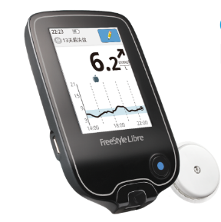
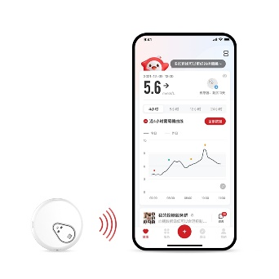
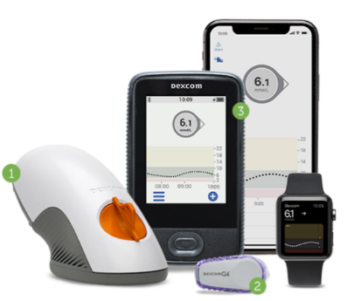
Classification of CGM
Real-time CGM
FGM
Bluetooth transmission
Automatically store blood glucose data without scanning
Hyperglycemia and hypoglycemia reminder
NFC transmission
Require users to actively scan the sensor to obtain current glucose data
Abbott Freestyle Libre 1 & 2
One use cycle
Reuse for transmitter
Simple installation, user-friendly operation
Reduce the risk of cross-infection
Smaller and more comfortable
More complicated for user operation
More work for disinfection when wearing, installing and reusing the transmitter
Increase the risk of nosocomial infection
Bigger size
Better experience for real-time CGM with one use cycle
FGM: Flash Glucose Monitoring
Dexcom G6

Slide 43
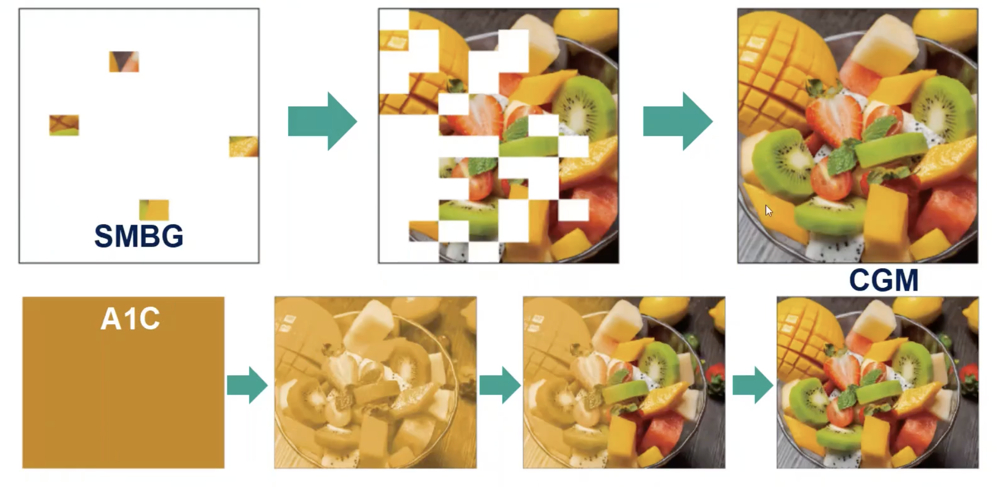
Technologies difference
CGM can display blood glucose information more clearly and completely than BGM and HbA1c

Slide 44
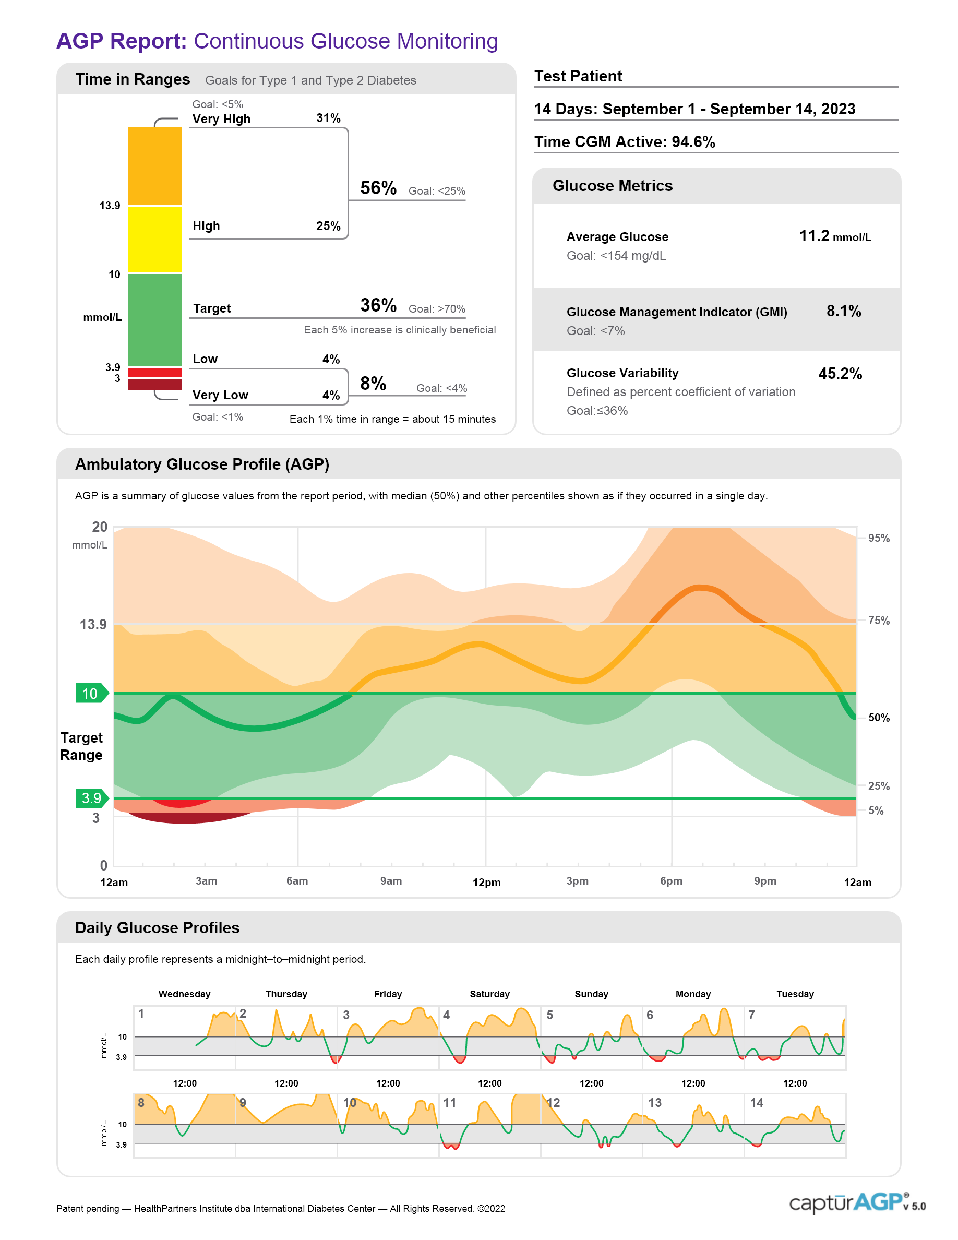
AGP report visualizes the full picture of blood glucose
indicators and objectives
Ambulatory Glucose Profile
、The AGP report accurately and intuitively reflects the fluctuations, stability, high blood glucose, and low blood glucose levels at different time periods.
Dynamic Glucose Curve
Continuous Glucose Curve

Slide 45
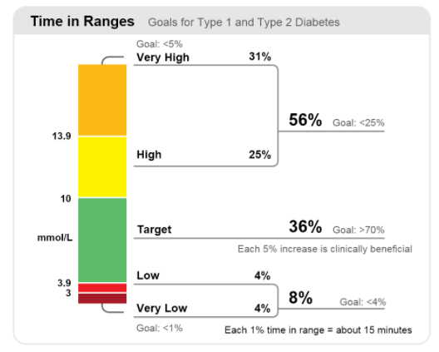
AGP report and Time In Range (TIR)
Time Above Range – TAR
A higher TAR value means you stayed above target range for a longer time.
Indicating higher risks of hyperglycemia.
Time In Range - TIR（Target over 70%）
The percentage of time that you stayed within your target glucose range, typically between 3.9-10mmol/L（70-180 mg/dL).
A higher TIR value means you stayed in target range for a longer time, and hence indicates better glucose control.
TIR target to be over 70%.
Time Below Range - TBR
A higher TBR value means you stayed below target range for a longer time.
Indicating higher risks of hypoglycemia.

Slide 46
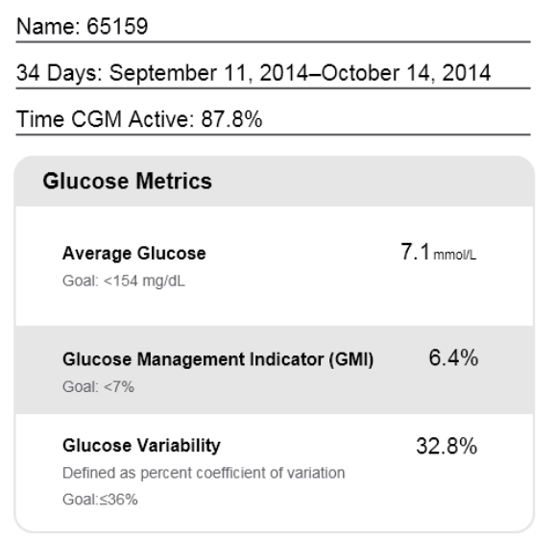
Indicators and objectives
Average Glucose:
Assesses the overall average blood glucose level.
Glucose Management Indicator (GMI):
Calculated from average glucose;
Estimates your future lab HbA1c.
Glucose variability（GV）:
Hypoglycemic risk factors and risk factors for diabetic complications.
Ideally a low number equal to or less than 36%.

Slide 47
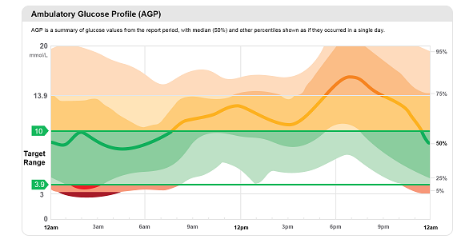
AGP report
Ambulatory Glucose Profile（AGP）
Reflects the patient's overall glucose fluctuations over several days.
Daily glucose profiles are combined to make a one day (24-hour) picture.
Ideally, lines would stay within green outlined area (target range)
AGP assists in determining whether blood glucose is on target by setting a target range 70-180 mg/dL.
Consists of 5 smooth curves, and 3 areas.
95th percentile
75th percentile
median
25th percentile
5th percentile
Heavy line:
Median (middle) line where half of the glucose values are above and half are below.
Ideally, the line is mostly flat and inside the green Target rage area 70-180 mg/dL.
Darker shading:
Area shaded darker shows 25-75% of the glucose values; ideally, space between is narrow.
Lighter shading:
5-25% % 75-95% of values.
Ideally, the closer the light shaded area is to the darker shaded area, the better.

Slide 48
Median glucose curve
The median glucose curve is the best fit curve described by the median of
all glucose readings at the same time.
A median glucose >180 mg/dL, or a median glucose 20% above target with a median increase of 40 mg/dL or more throughout the day, suggests that glycaemic control is suboptimal and that an adjustment to the glucose-lowering regimen is needed.
median
Reflects glucose fluctuations, with flatter curves indicating better glucose stability.

Slide 49
IQR: 25th and 75th percentile glucose curves
The IQR (interquartile range) is represented by the 25th and 75th percentile curves.
The IQR is influenced by physiological status (e.g. insulin resistance, excess hepatic glucose production, etc.) and medication. Observing the IQR allows for a specific discussion of the different time periods and determines the need for changes in the patient's treatment regimen, such as adjustments in medications and insulin dosage.
the 25th to 75th percentile
IQR shows day-to-day blood glucose fluctuations, with wider intervals suggesting greater fluctuations, and with narrower intervals suggesting lesser fluctuations.
、

Slide 50
5th and 95th percentile glucose curves
The IDR (interdecile range) is represented by the 5th and 95th percentile curves.
The main influence on IDR is lifestyle, including diet, exercise and treatment compliance.
the 5th to 95th percentile
IDR shows day-to-day blood glucose fluctuations, with wider intervals suggesting greater fluctuations, and with narrower intervals suggesting lesser fluctuations.

Slide 51




